Slide 1
ASSIGNMENT #1
Measures of Central Tendency

Slide 2
Group Members
Ahmed Ali (B20102013)
Annas Baig (B20102078)
Muhammad Amas Waseem (B20102077)
Muneeb Adil (B20102125)
Subhan Ahmed (B20102148)
Syed Zawwar Ahmed (B20102173)
Tayyab Ayub (B20102178)
Zunain Ali Azam (B20102183)

Slide 3
Function
Functions can accept more than one input arguments and may return more than one output arguments.
Syntax:
function [out1,out2, ..., outN] = my_fun(in1,in2,in3, ..., inN)
.
.
.
end

Slide 4
Quartiles
Compute the Q1,Q2,Q3 for the following data.

Slide 5
Function (UG Quartile)
function []=UG_Quartile(d,N) %d=Raw data and N=Quartile numbers
f = sort(d);
len_f = length(d); %len_f=No of entities in raw data
len_N = length(N); %len_N=Number of quartiles to be calculated
for j = 1:len_N
i = N(j);
th_value = i*(len_f+1)/4;
a = floor(th_value); % a must be a integer number OR NUMBERS BEFORE DECIMAL
b = th_value-a; % b= numbers after decimal
if(i<1 || i>3)
disp('INVALID QUARTILE’);
elseif(th_value>len_f)
Quartile = f(len_f);
disp(Quartile);
elseif(a==0)
Quartile = f(1);
disp(Quartile);
elseif(b==0)
Quartile = f(th_value);
disp(Quartile);
else
x = f(a);
y = f(a+1);
Quartile = x+(b*(y-x));
disp(Quartile);
end
end
end

Slide 6
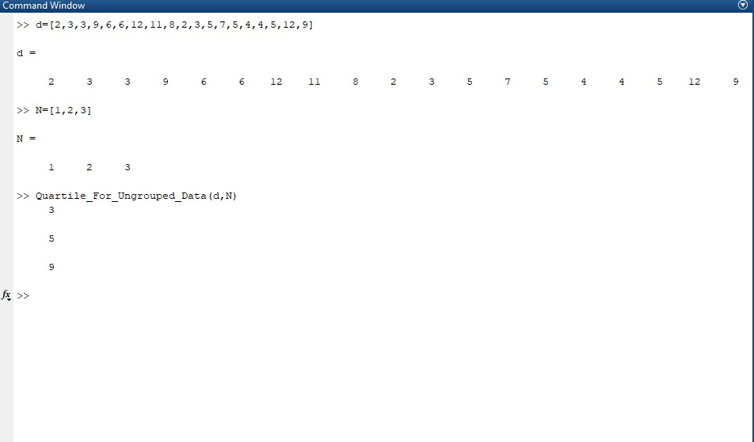
Output of Quartiles (UG)

Slide 7
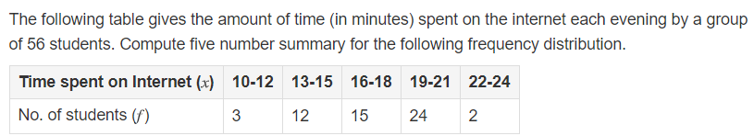
For Grouped data : Quartiles
Compute the Q1,Q2,Q3 for the following data.

Slide 8
Function
function [quartile] = Quartile_For_Grouped_Data (L, U, F, i)
if (i<1 || i>3)
fprintf('Invalid Quartile\n')
else
n = sum(F);
quarter_of_n = n/4;
cf = cumsum(F);
j = cf(1);
index = 1;
while (j<=i*quarter_of_n)
if(cf(index)>=i*quarter_of_n)
j = cf(index);
median_class = index;
end
index = index + 1;
end
l = L(median_class);
preceeding_cf = cf(median_class - l);
f = F(median_class);
h = U(1)-L(1);
quartile = 1+((h/f)*((i*n/4)-preceeding_cf));
end
end

Slide 9
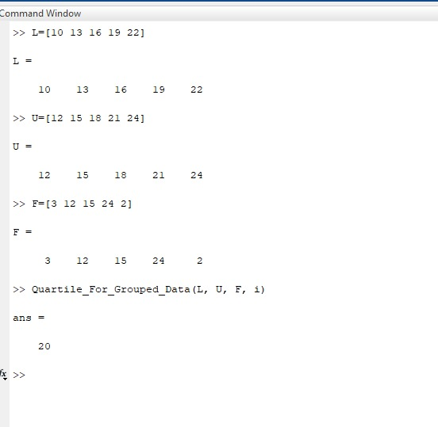
Output of Quartiles (G)

Slide 10
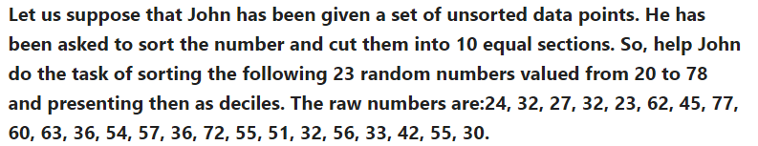
Deciles
Compute the D1,D2……D10 for the following data.

Slide 11
Function (UG Decile)
function []=UG_Decile(d,N) %d=Raw data and N=Decile numbers
f = sort(d);
len_f = length(d); %len_f=No of entities in raw data
len_N = length(N); %len_N=Number of deciles to be calculated
for j = 1:len_N
i = N(j);
th_value = i*(len_f+1)/10;
a = floor(th_value); % a must be an integar number OR NUMBERS BEFORE DECIMAL
b = th_value-a; % b= numbers after decimal
if(i<1 || i>9)
disp('INVALID DECILE’);
elseif(th_value>len_f)
Decile = f(len_f);
disp(Decile);
elseif(a==0)
Decile = f(1);
disp(Decile);
elseif(b==0)
Decile = f(th_value);
disp(Decile);
else
x = f(a);
y = f(a+1);
Decile = x+(b*(y-x));
disp(Decile);
end
end
end

Slide 12
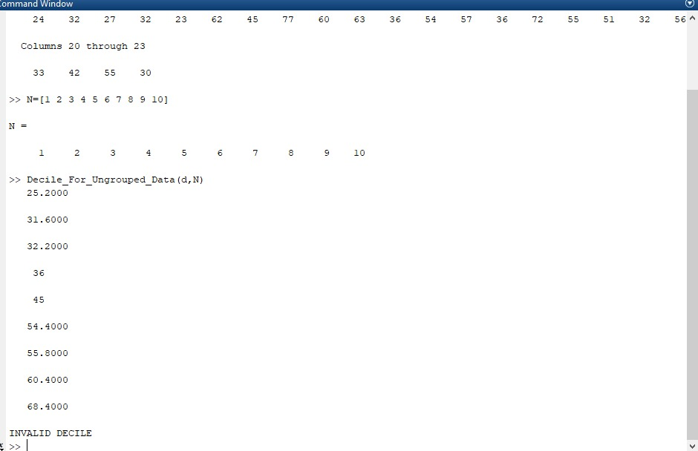
Output of Decile (UG)

Slide 13
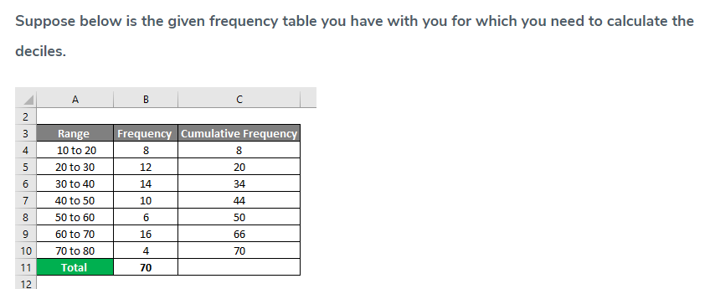
Grouped Deciles
Compute the D1,D2……D10 for the following data.

Slide 14
Function
function [] = Decile_For_Grouped_Data (L, U, F, N)
for i=1:length(N)
if (N(i)<1 || N(i)>9)
disp('Invalid Decile’)
else
n = sum(F);
tenth_of_n = n/10;
cf = cumsum(F);
j = cf(1);
index = 1;
while (j<=N(i)*tenth_of_n)
if(cf(index)>=N(i)*tenth_of_n)
j = cf(index);
median_class = index;
end
index = index + 1;
end
l = L(median_class);
preceeding_cf = cf(median_class - 1);
f = F(median_class);
h = U(1)-L(1);
decile = 1+((h/f)*((N(i)*n/10)-preceeding_cf));
disp(decile);
end
end
end

Slide 15
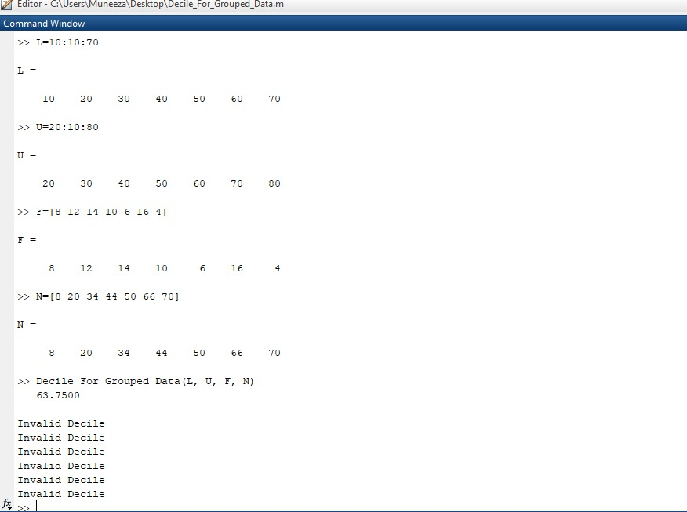
Output of Decile (G)

Slide 16
Percentile
Compute the p1,p2,….p100 for the following data.
NOTE:
Consider random 40 numbers

Slide 17
Function (UG Percentile)
function []=UG_Percentile(d,N) %d=Raw data and N=Percentile number
f=sort(d);
len_f = length(d); %len_f=No of entities in raw data
len_N = length(N); %len_N=Number of percentiles to be calculated
for j = 1:len_N
i = N(j);
th_value = i*(len_f+1)/100;
a = floor(th_value); % a must be an integar number OR NUMBERS BEFORE DECIMAL
b = th_value-a; % b = numbers after decimal
if(i<1 || i>99)
disp('INVALID PERCENTILE’);
elseif(th_value>len_f)
Percentile = f(len_f);
disp(Percentile);
elseif(a==0)
Percentile = f(1);
disp(Percentile);
elseif(b==0)
Percentile = f(th_value);
disp(Percentile);
else
x = f(a);
y = f(a+1);
Percentile = x+(b*(y-x));
disp(Percentile);
end
end
end

Slide 18
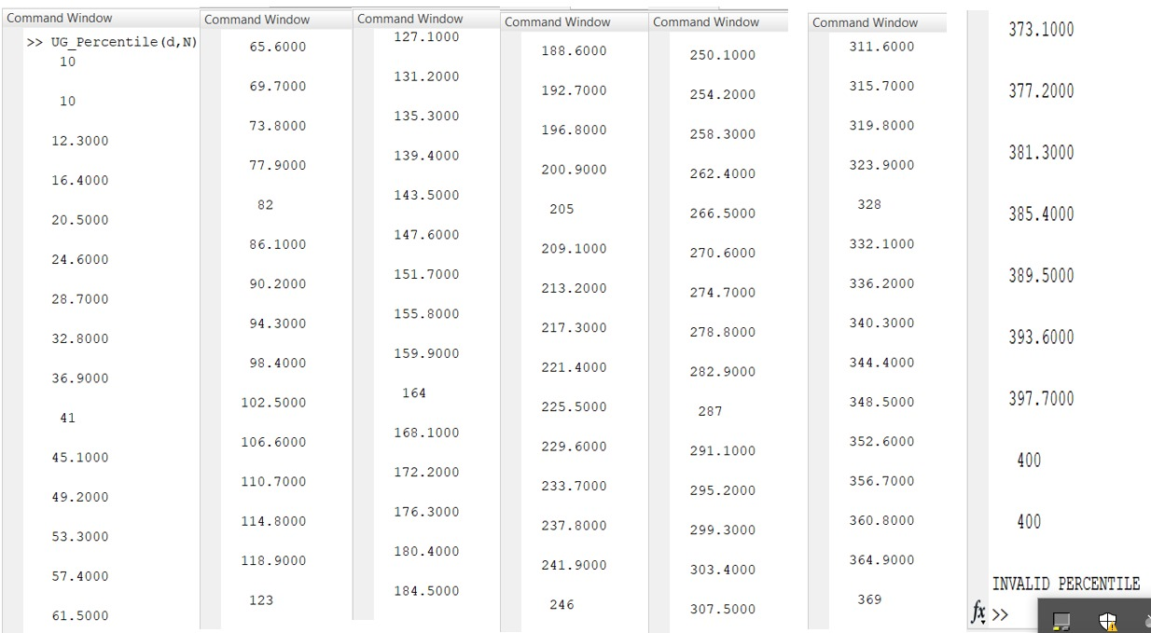
Output of Percentile

Slide 19
Grouped Percentile
Compute the p1,p2,….p100 for the following data.

Slide 20
Function
function [] = Percentile_For_Grouped_Data(L, U, F, N)
for i=1:length(N)
if(N(i)<1 || N(i)>99)
disp(‘Invalid Decile’)
else
n=sum(F);
percent_of_n=n/100;
cf=cumsum(F);
j=cf(1);
index=1;
while (j<=N(i)*percent_of_n)
if(cf(index)>=N(i)*percent_of_n)
j=cf(index);
median_class=index;
end
index=index+1;
end
l=L(median_class);
preceeding_cf=cf(median_class-1);
f=F(median_class);
h=U(1)-L(1);
percentile=l+((h/f)*((N(i)*n/100)-preceeding_cf));
disp(percentile);
end
end
end

Slide 21
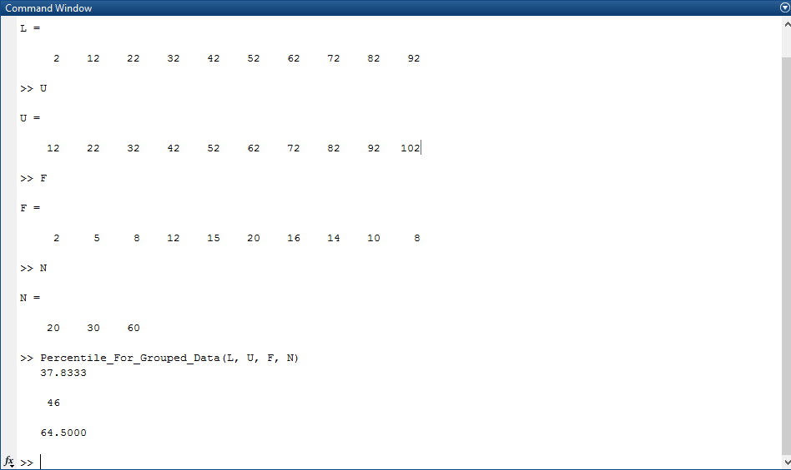
Output of Percentile (G)

